Slide 1
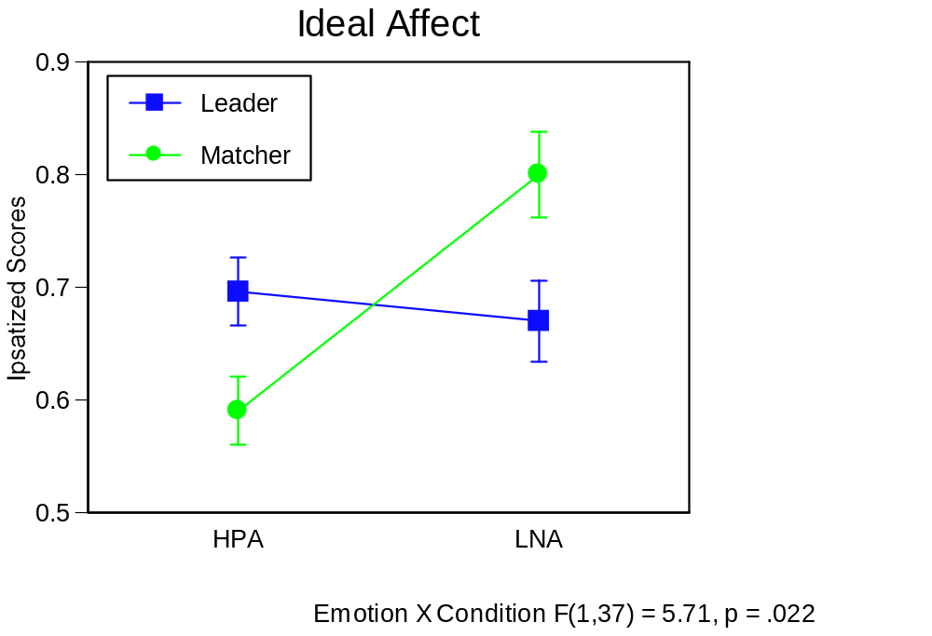
(controlling for Global Ideal HPA, for which there was a significant main effect of condition, p = .056)

Slide 2
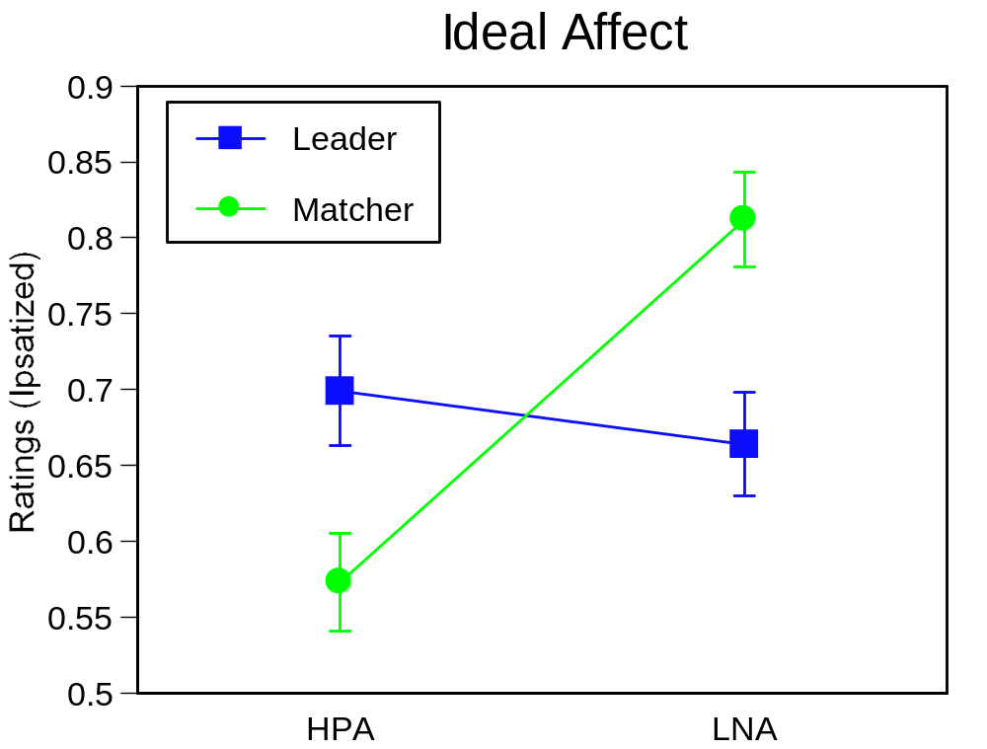
Within Ss: Condition X Type F[1,28] = 9.27, p <.01

